Slide 1

Deep Learning Techniques for Gesture Recognition: Where to Split the Complexity
Matteo Drago, Riccardo Lincetto
Dept. of Information Engineering, University of Padova, Italy
Prof. Michele Rossi
matteo.drago@studenti.unipd.it
riccardo.lincetto@studenti.unipd.it
September, 5, 2018

Slide 2
Outline
mmWave Cellular Networks
Proposed architecture
Performance evaluation
ns-3 mmWave module
Results
Conclusions

Slide 3

3GPP New Radio
New RAN
OFDM-based PHY with flexible configurations
Support for
Higher frequencies (mmWaves)
Ultra-low latency
New Core Network
Softwarization of network nodes
Network slicing

Slide 4
mmWave for the mobile RAN
Potentials
Bandwidth
Large arrays in small space
Challenges
High propagation and penetration loss
Directionality
Blockage
3GPP Rel. 15 supports carrier frequency up to 52.6 GHz

Slide 5
Applications
Ultra-high quality video streaming and VR are seen as possible use cases of 5G
How can we stream high quality video to mmWave users?

Slide 6
Related work
IEEE 802.11ad solutions for VR and streaming in local networks
Very different setup from cellular networks [1]
LTE streaming solutions
Different frequency bands and less demanding propagation conditions
Also using network coding [2]
[1] O. Abari, D. Bharadia, A. Duffield, and D. Katabi, “Enabling high-quality untethered virtual reality,” in 14th USENIX Symposium on Networked Systems Design and Implementation (NSDI 17). USENIX Association, pp. 531–544
[2] D. Vukobratovic, C. Khirallah, V. Stankovic ́, and J. S. Thompson, “Random Network Coding for Multimedia Delivery Services in LTE/LTE- Advanced,” IEEE Transactions on Multimedia, vol. 16, no. 1, pp. 277– 282, January 2014

Slide 7
mmWave Video Streaming Architecture
Application layer solution implemented in Mobile Client and Video Streaming Server (VSS)
Multi connectivity
Network coding

Slide 8
Multi connectivity in mmWave networks
Increases resiliency and improves end-to-end performance
Combine links at different frequencies
In the RAN [1] (LTE-NR Dual Connectivity, Carrier Aggregation)
At the transport layer (Multipath TCP [2])
[1] M. Polese, M. Giordani, M. Mezzavilla, S. Rangan, and M. Zorzi, “Improved Handover Through Dual Connectivity in 5G mmWave Mobile Networks,” IEEE Journal on Selected Areas in Communications, vol. 35, no. 9, pp. 2069–2084, September 2017.
[2] M. Polese, R. Jana, and M. Zorzi, “TCP and MP-TCP in 5G mmWave Networks,” IEEE Internet Computing, vol. 21, no. 5, pp. 12–19, September 2017.

Slide 9

Multi connectivity for video streaming
We exploit multi connectivity at application layer
LTE: low rate, high reliability
mmWave: high rate, lower reliability
LTE is used also to provide feedback from the user to the VSS
Video Encoder
Video Distribution Layer
UDP
UDP
IP
IP
LTE
mmWave

Slide 10
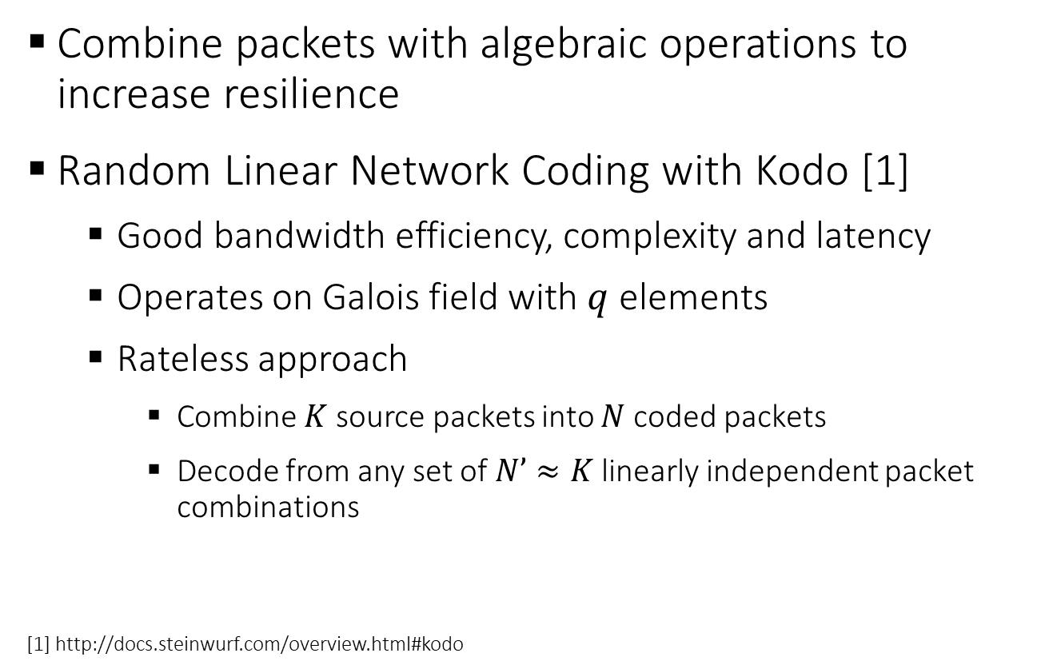
Network coding
Combine packets with algebraic operations to increase resilience
Random Linear Network Coding with Kodo [1]
Good bandwidth efficiency, complexity and latency
Operates on Galois field with $q$ elements
Rateless approach
Combine $K$source packets into $N$coded packets
Decode from any set of $N’≈K$linearly independent packet combinations
[1] http://docs.steinwurf.com/overview.html#kodo
Notes:
Non serve andare troppo nei dettagli

Slide 11
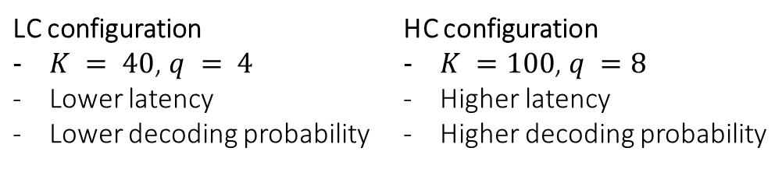
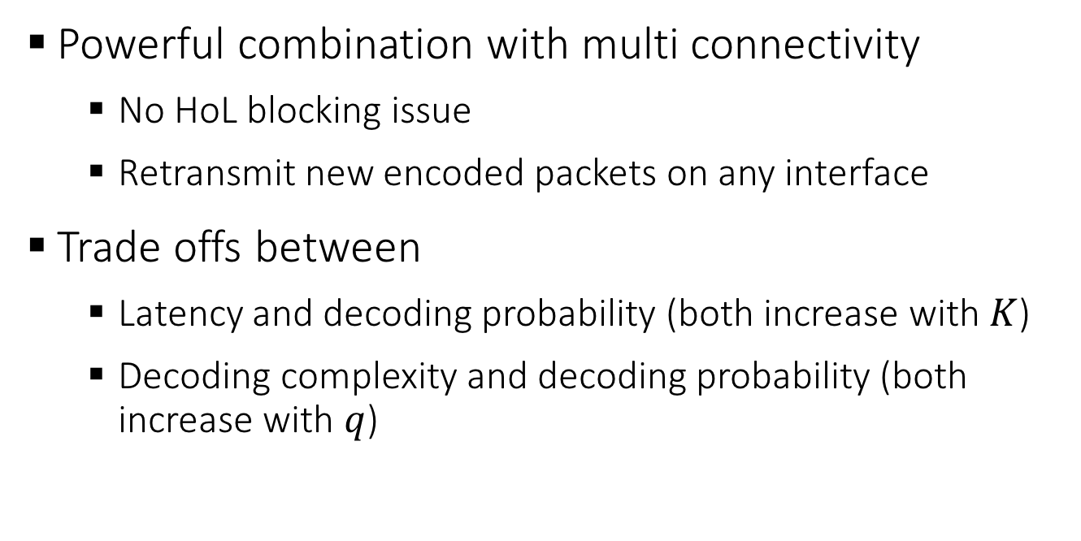
Network coding for video streaming
Powerful combination with multi connectivity
No HoL blocking issue
Retransmit new encoded packets on any interface
Trade offs between
Latency and decoding probability (both increase with $K$)
Decoding complexity and decoding probability (both increase with $q$)
LC configuration $K = 40$, $q = 4$ Lower latency Lower decoding probability | HC configuration $K =100$, $q =8$ Higher latency Higher decoding probability

Slide 12
Video encoding
H.264 with Scalable Video Coding extension
Temporal layers
Frames with different importance in temporal domain
Spatial layers
Encode different resolutions in the same bit stream

Slide 13
Realistic video streaming extension
We simulate the streaming, buffering and play-out of video frames from a real video
Tools
JSVM to extract the H.264 bitstream
FFmpeg for video decoding and quality evaluation
Custom SVEF extension for adaptation of the bistream to ns-3
Notes:
Non entrare troppo nei «dettagli di codice» ma fare ad esempio un’immagine/diagramma a blocchi per rappresentare i diversi step eseguiti

Slide 14

Simulation scenario
Comparison between
LC and HC network coding setups
Retransmission policies
RAN retransmissions (HARQ and RLC AM)
Network coding FEC
Obstacle
UE
UE

Slide 15
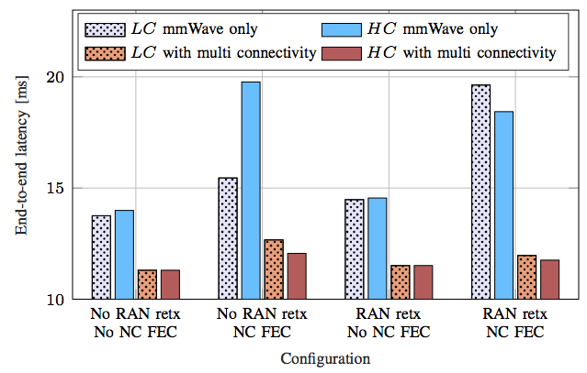
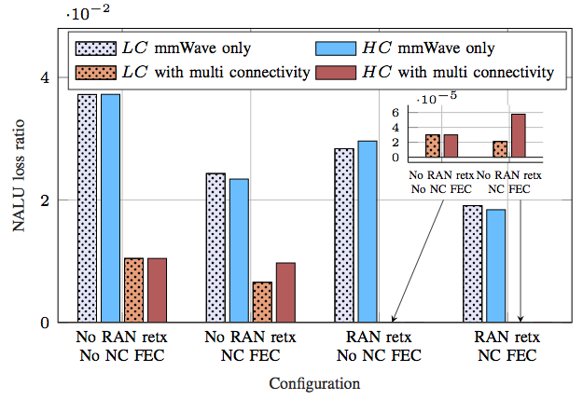
End-to-end latency and NALU* loss
Multi connectivity yields the largest gain
Without multi connectivity, NC performs better for NALU loss at the cost of higher latency
*NALU: portion of the video bitstream mapped to a network packet
Latency
NALU loss
Notes:
Latenza elevata dovuta alla richiesta di un numero più alto di pacchetti codificati

Slide 16
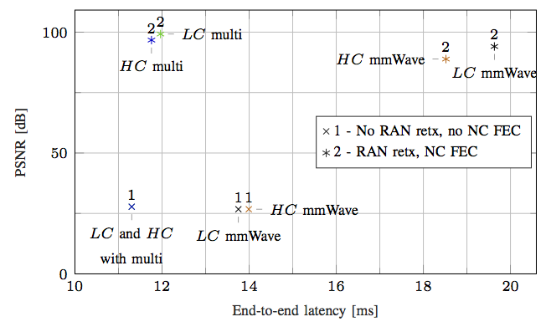
PSNR
Inversely proportional to MSE between received and transmitted frame, maximum value with FFmpeg 99.99 dB
Proposed solution with multi connectivity and network coding
Lower latency
Higher video quality

Slide 17
Conclusions
Video streaming architecture for mmWave networks
Evaluated with realistic ns-3 mmWave and video streaming model
Improved video quality with low latency
Useful for high quality live streaming
Important interplay between multi connectivity and network coding
Future work
Implementation of NOW and EW approaches

Slide 18

Reliable Video Streaming over mmWave with Multi Connectivity and Network Coding
Matteo Drago*, Tommy Azzino*, Michele Polese*,
Cedomir Stefanovic^{v}, Michele Zorzi*
*Dept. of Information Engineering, University of Padova, Italy
^{V}Aalborg University, Copenhagen, Denmark
matteo.drago@studenti.unipd.it
tommy.azzino@studenti.unipd.it
mmwave.dei.unipd.it
April, 27, 2018

